Slide 1
Digital Clock Project
Tess Anderson and Matthew Carrico

Slide 2
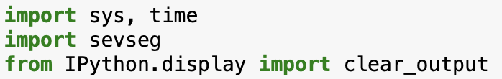
Import sys, time
sys module provides access to some variables used or maintained by the interpreter and to functions that interact strongly with the interpreter.
Time module provides various time-related functions
Import sevseg
simple Python module that produces ASCII art of seven-segment display numbers.
Displays time in traditional “digital clock format”
Clear_output allows it to refresh every second

Slide 3
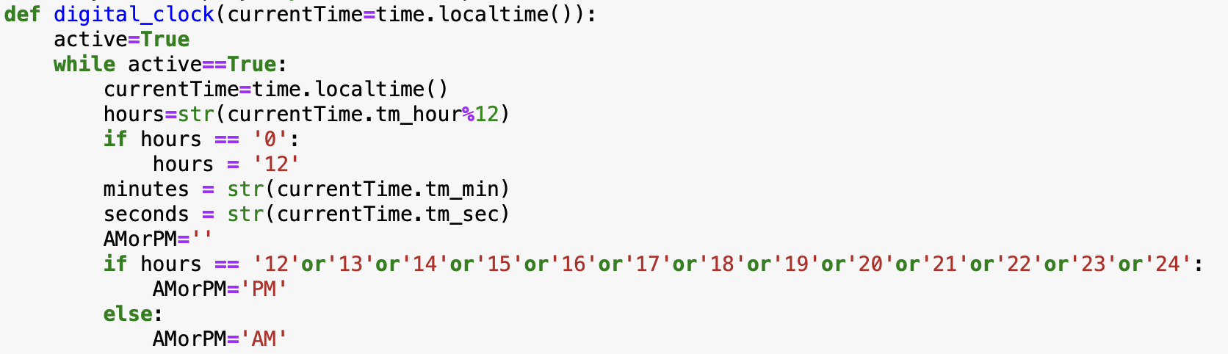
While True (loop forever)
Time.localtime() converts to local time. If secs is not provided or None, the current time as returned by time() is used
We break the information from this command into variables that contain a string with time information.
IF condition for AM or PM

Slide 4
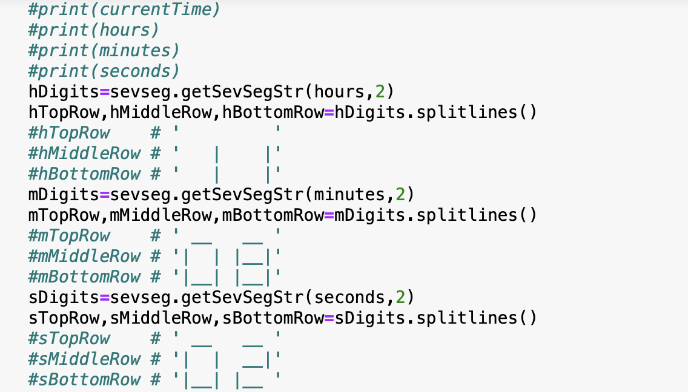
Print time with sevseg one line at a time –
top row of hours, minute, seconds;
middle row of hours, minutes, seconds;
bottom row of hours, minutes, seconds.

Slide 5
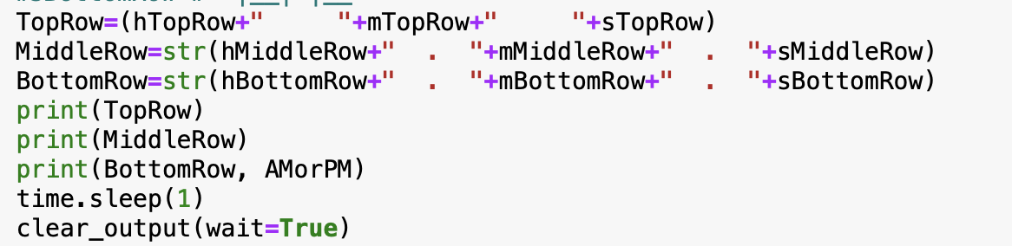
Print time with sevseg one line at a time –
top row of hours, minute, seconds;
middle row of hours, minutes, seconds;
bottom row of hours, minutes, seconds.

Slide 6
